Slide 1
Capstone project presentation on Image compression
Under the guidance of samreen fayaz

Slide 2



Presented by-
Adarsh Khare 11612923
Sabid Ansari
11617037
Tarun Singh Mahar 11608343
Vamja Chintan
11610527

Slide 3







Presentation flow
INTRODUCTION
THE PROBLEM
EXISTING SYSTEM
PROBLEM ANALYSIS
SOFTWARE ANALYSIS
DESIGN
IMPLEMENTATION

Slide 4
INTRODUCTION
Image Compression is another form of data compression which is applied to the digital images to reduce its size and the storage sufficiency.
The objective of Image Compression is to store the image into bit-stream as compact as possible and to display the decoded image in the monitor as exact as possible.
What is Image Compression?
The image file is converted into a series of binary data, which is called the bit- stream.
The decoder receives the encoded bit-stream and decodes it to reconstruct the image.
The total data quantity of the bit-stream is less than the total data quantity of the original image
Flow of Compression

Slide 5


Types
Lossless image compression is a compression algorithm that allows the original image to be perfectly reconstructed from the original data.
Lossy image compression is a type of compression where a certain amount of information is discarded which means that some data are lost and hence the image cannot be decompressed with 100% originality.
Image Compression
Lossless
Lossy

Slide 6
NEED OF PROJECT
To understand the need for image compression, consider the amount of data required to represent a 2 hour Standard Definition (SD) using 720 x 480 x 24 bit pixel arrays.
A video is a sequence of video frames where each frame is a full color still image.
Because video player must display the frames sequentially at rates near 30fps, SD video data must be accessed at
30fps x (729x480)ppf x 3bpp =31,104,000 bps
fps – frame per second
ppf – pixels per frame
bpp – byte per pixel
bps – byte per second

Slide 7
NEED OF PROJECT
Thus a 2 hour movie consists of
31,104,000 bps x (60)² sph x 2 hrs ~= 2.24 x 10¹¹ bytes.
OR
224GB of data
sph – second per hour
To put a 2 hrs movie on a single DVD, each frame must be compressed by a factor of around 26.3.
The compression must be even higher for HD, where image resolution reach 1920 x 1080 x 24 bits/image.
Web pages images & High-resolution digital camera photos are also compressed to save storage space & reduce transmission time.
Compression can reduce the transmission time by a factor of around 2 to 10 or more.

Slide 8

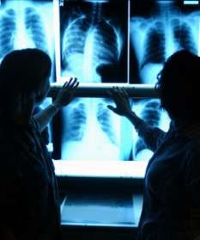
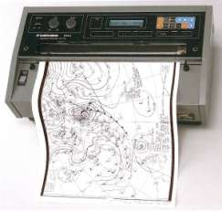
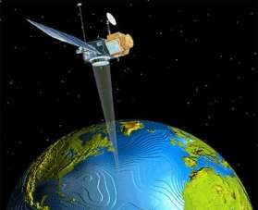
NEED OF PROJECT
Along with these applications, image compression plays an important role in many other areas including:

Slide 9
EXISTING SYSTEM
There are many websites which works on image compression, but they dramatically reduces the pixel quality of the images but in our software by using Machine Learning we tried to increase the image quality with decrease in size of image. The system can be easily extendable as per the requirement.
Our models is made using CNN(convolutional neural network) which does which is used in compression of the image in better manner.

Slide 10
Problem analysis
Major problem analysis done during the whole journey of the software are:
There were many image dataset so which dataset to use was one of the major concern as our whole training of the model is based on it.
Hardware requirement for training our model.
Time complexity problem: It was taking too much time to compress the image which we handled.
Linking of the GUI with our back-end code.

Slide 11






SOFTWARE REQUIREMENT ANALYSIS
User Interface
Dataset Availability
Administrative functions
Security
Performance
Reliability

Slide 12

Dataset used:
We have used Caltech-256 Object Category Dataset .
There are total 30608 images at least 80 images per category.
This is a great dataset to train models related image problems.

Slide 13
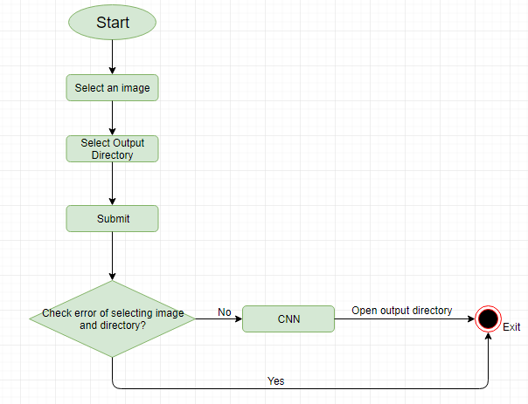
Flow of the project

Slide 14
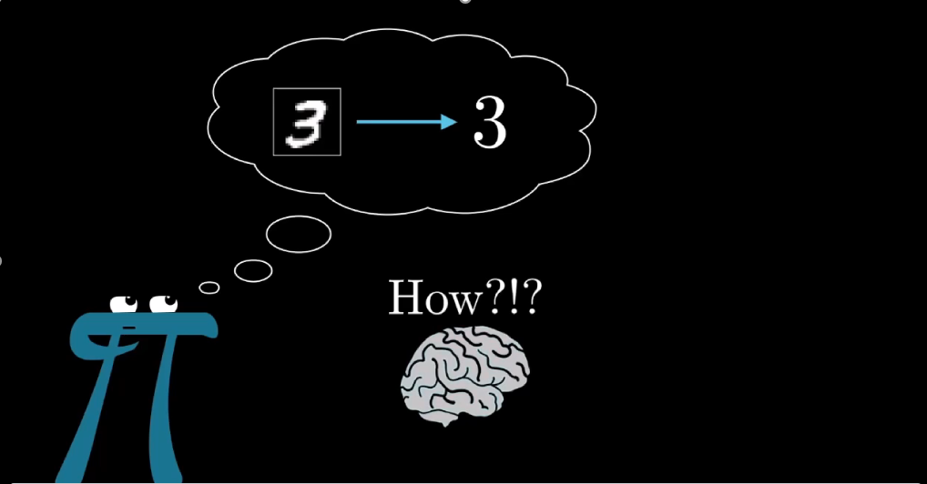
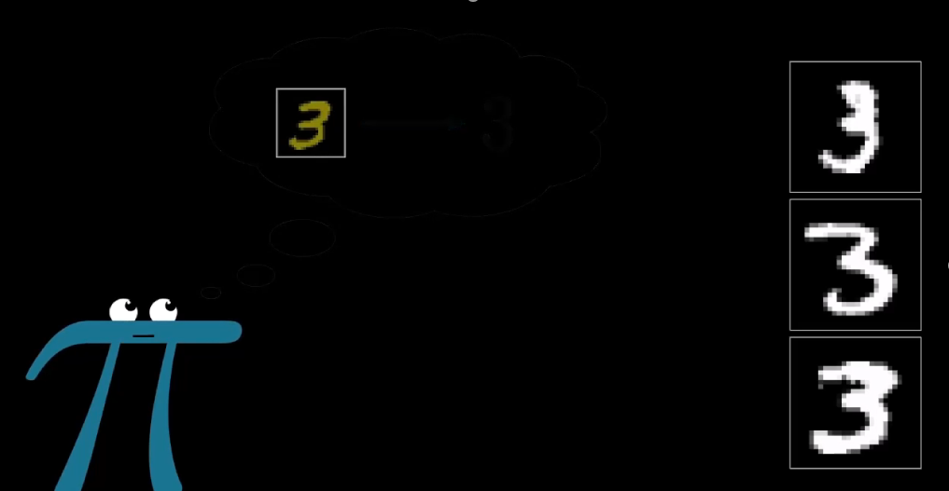
Main algorithm - cnn
How a fresh brain recognize?

Slide 15
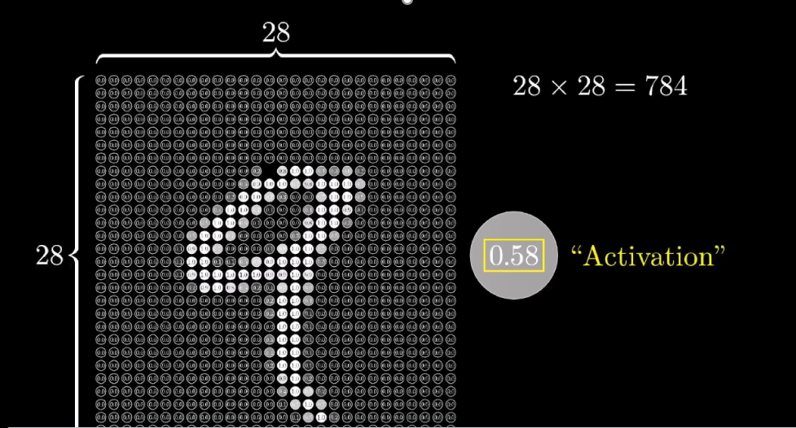
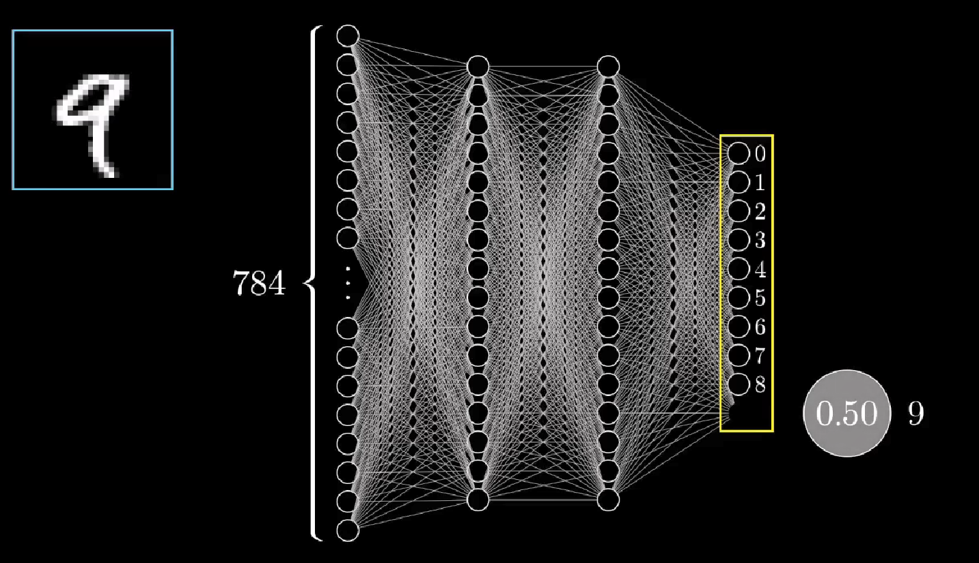
Main algorithm - cnn
How a CNN process it?

Slide 16
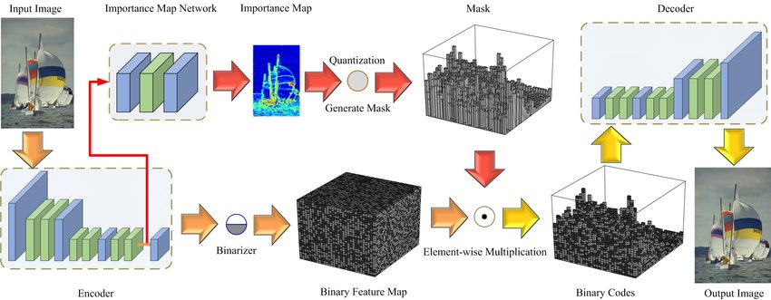
Main algorithm - cnn

Slide 17
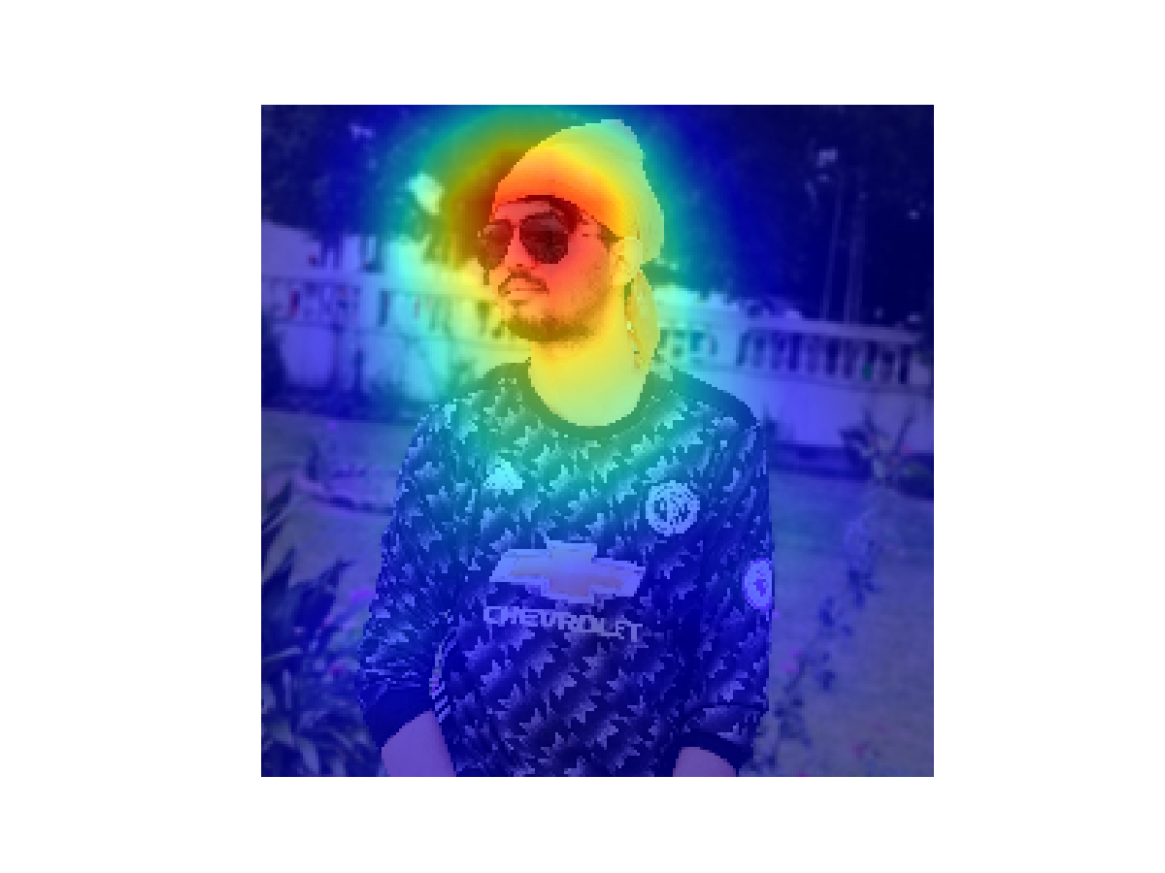

Implementation
In our compress file we have implemented our two modules where we create our Importance map and binary map where we use our model which we have trained to get the important feature of the images in the first part as for the second part we try to combine both Importance map (Figure a) and Binary map (Figure b) to get our compressed images.
(a) Importance Map (b) Binary Map

Slide 18


Implementation
Here, we combined both Importance map (Figure a) and Binary map (Figure b) to get our compressed images as shown below:
Original Image (Size: 1.5 MB) Compressed Image (Size: 185 KB)

Slide 19
design
We have tried to keep the design of the application very simple and easy to understand. The application can be easily run-on python having Tkinter, pillow, NumPy, TensorFlow, pandas, matplotlib, scikit and SciPy libraries installed. The image is the main input require by the application for the compression purpose. The administrator of the application can easily change the code as per the requirement. He has the privilege to remove the any module or to add new module to the system.

Slide 20
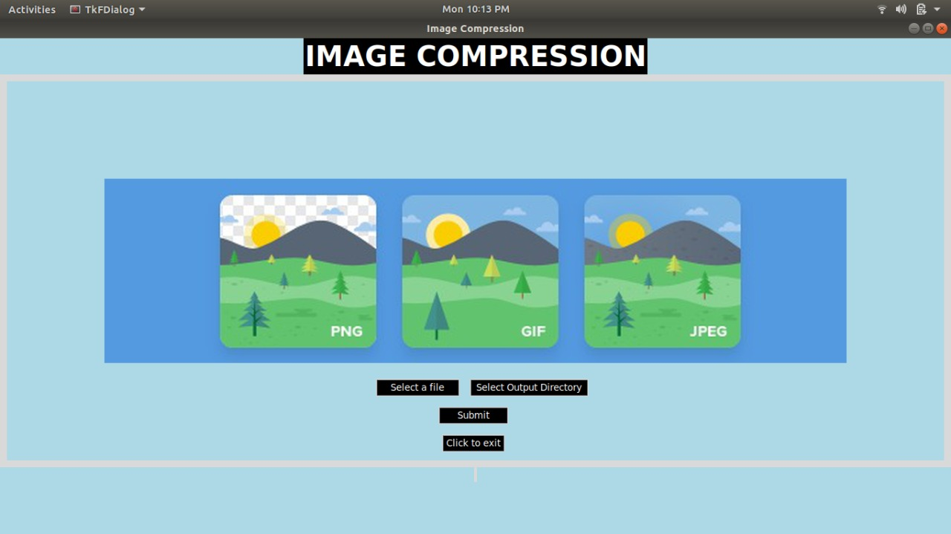
GUI snapshot

Slide 21
Thank you

